Slide 1
BlazeMeter and Load Impact
ataichi.github.io - Tutorial by Tricia Nieva

Slide 2
Loading . .
Everything was perfect . .

Slide 3
BlazeMeter and Load Impact
Used for Load and Performance Tests
Identifies maximum capacity
Users
Data
Can create virtual users
Determine how long it takes to load
Min (best case)
Max (worst case)

Slide 4
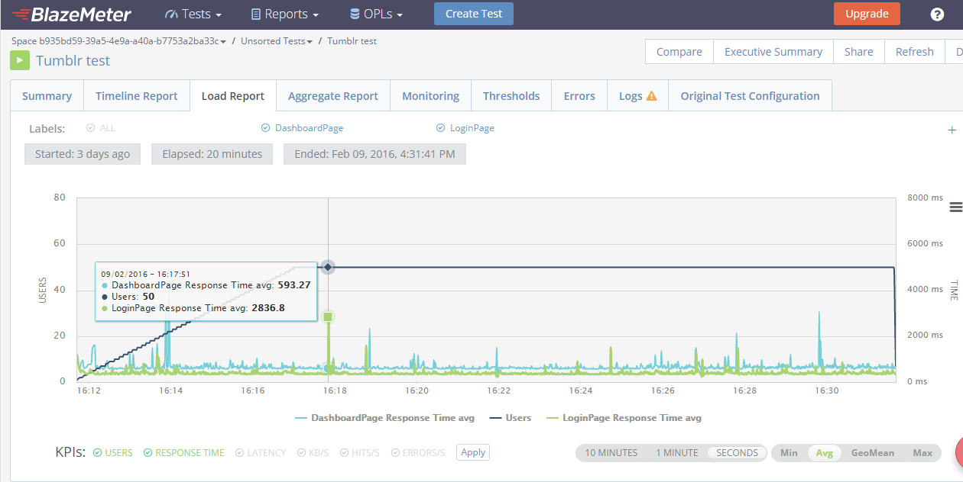

Slide 5
Importance
Enrolment
Online Shopping
Bank Transactions
Individual
Entrepreneurs
Downloading Resources

Slide 6
Advantages of these Performance Test Tools
Self Service
Uses the Cloud (Start it now, open again later)
Automation of Tests
Less Physical Machines and Real Users
Presents the importance of Time and Baselines
Saves a Company from Losing Profit

